Slide 1
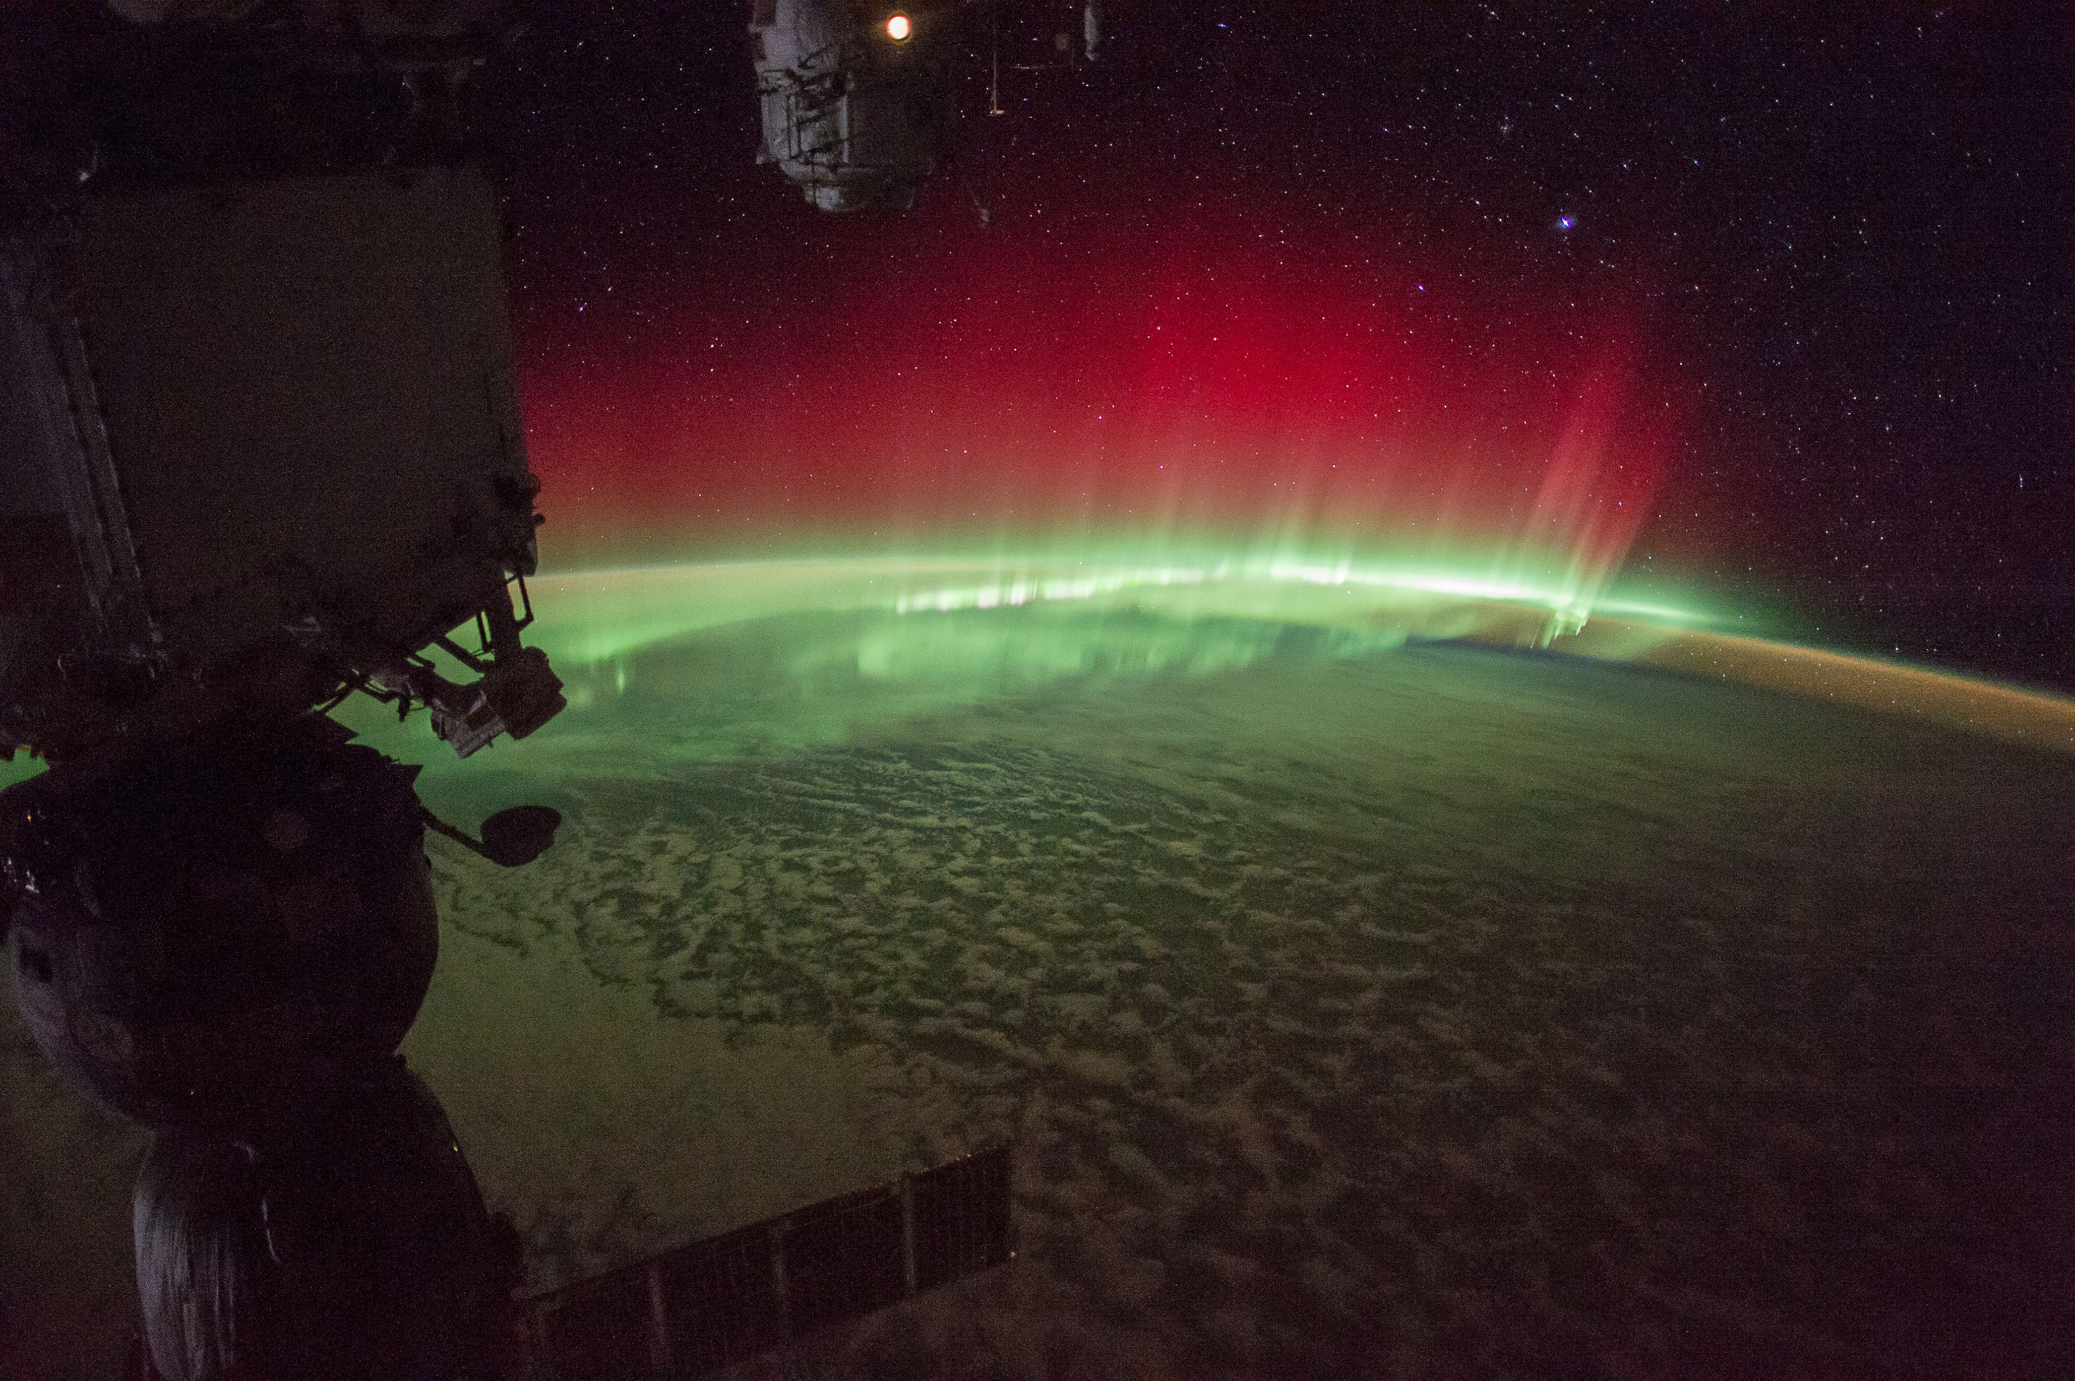
Tutorial:
Space Weather Impacts on Space Assets
Dr. Joseph I Minow
NASA Technical Fellow for Space Environments
CCMC Space Weather School, Science of Space Weather Workshop
Goa, India 24 January 2016
joseph.minow@nasa.gov

Slide 2
Space Weather and Spacecraft Operations
The primary approach for the spacecraft industry to mitigate the effects of space weather is to design satellites to operate under extreme environmental conditions to the maximum extent possible within cost and resource constraints
    “Severe Space Weather Events--Understanding Societal and Economic Impacts Workshop Report,”
    National Academies Press, Washington, DC, 2008
    http://www.nap.edu/catalog/12507.html
This technique is rarely 100% successful and space weather will typically end up impacting some aspect of a space mission
Some space weather issues are common to all spacecraft, e.g., space situational awareness is one example
Specific details of space weather interactions with a spacecraft are often unique because spacecraft systems are unique
There is no “standard” space weather impact to a satellite or space weather support requirements for mission operations
Notes:
Spacecraft designers attempt to avoid problems due to the space environment. However, when they cannot then space weather can impact spacecraft operations.

Slide 3
Space Environment Effects
NASA CCMC
Notes:
Different aspects of the space environments impact space systems in many different ways.

Slide 4
Space Environment Effects
NASA CCMC
Notes:
Different aspects of the space environments impact space systems in many different ways. This presentation will focus on examples of spacecraft charging and ionizing radiation effects on spacecraft.

Slide 5
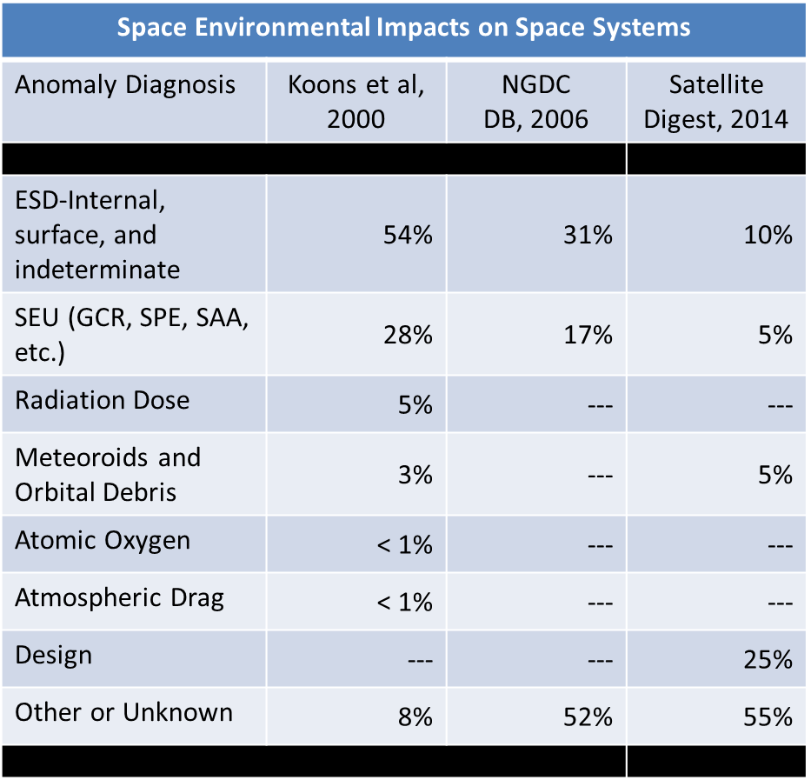
Space Environment Effects
[McKnight, 2015]
Notes:
Why consider only charging and ionizing radiation? Time is limited for this presentation so I’ve chosen to focus on the primary space weather environments responsible for many of the anomalies reported by spacecraft operators. Note, however, that it is sometimes difficult to accurately attribute an anomaly to a particular space environment and results from anomaly studies vary from one source to the next. The results here are from three different sources where spacecraft anomalies have been attributed to some factor in the space environment.

Slide 6
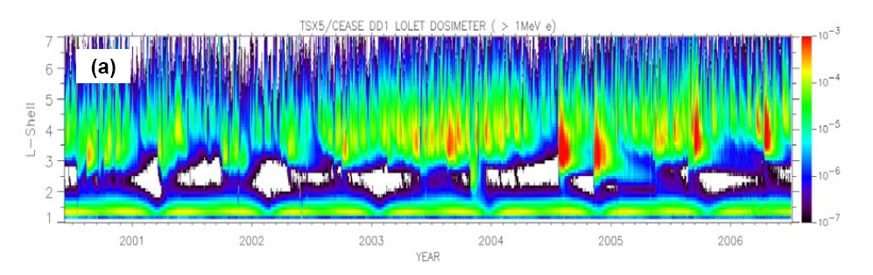
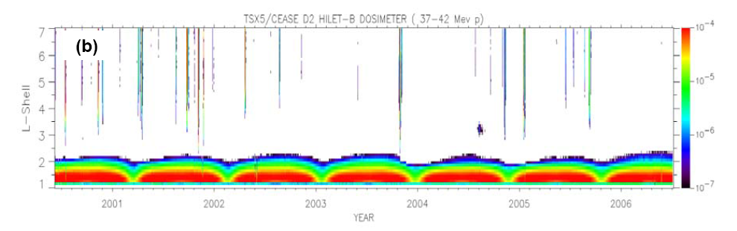
Radiation Belt Energetic Electrons and Protons
TSX-5 410 km x 1750 km x 69°
e-
p+
Dose rate [rad(Si) sec−1] averaged over five seconds for the entire TSX-5 mission from two CEASE dosimeter channels measuring mostly (a) >1 MeV electrons and (b) 37–42 MeV protons.
Metcalf et al., 2007
Notes:
Dose rate due to energetic >1 MeV electron (top panel) and 37-42 MeV protons (bottom panel) as a function of magnetic L-shell. The dose rates due to electrons are more variable in the outer radiation belt (2.5 < L < 7 Re) than dose rates due to both electrons and protons in the inner belt (1 < 2.5 Re). Space weather variations due to geomagnetic storms results in a more variable radiation dose environment in the outer radiation belt than the more stable environments in the inner radiation belt. The proton “stripes” at large L-shells in the outer belts are due to solar protons penetrating deep within the magnetosphere. Solar protons therefore represent a space weather environment not only in interplanetary space but in the Earth’s outer magnetosphere as well.

Slide 7
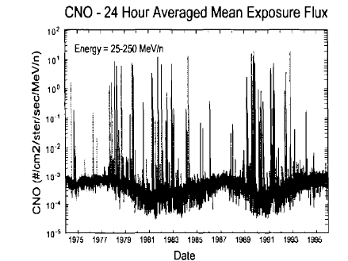
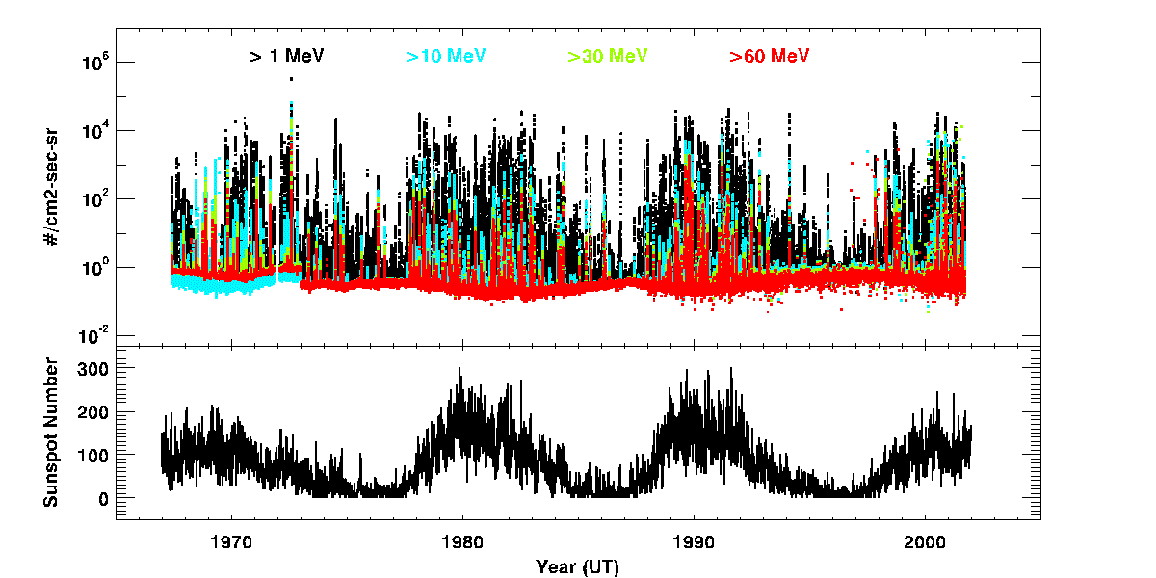
Solar Protons and Galactic Cosmic Rays
GCR
  Anti-correlated with solar cycle
  Small flux variation
SEP
  Correlated with solar cycle
  Large flux variation
Protons
Average sunspot number
http://omniweb.gsfc.nasa.gov/
Notes:
Energetic carbon, nitrogen, and oxygen ions (top panel) for a period covering two solar cycles and energetic protons (top frame of bottom panel) covering four solar cycles. The average sun spot number (bottom frame of bottom panel) is provided to show the phase in solar cycle. The slowly varying background flux of energetic ions due to galactic cosmic rays (GCR) peaks during solar minimum when the GCR ions have easier access to the inner heliosphere. Episodic increases in ion flux by orders of magnitude are energetic solar particle events (SPE). The occurrence rate of SPE’s are generally correlated with solar activity and peak during solar maximum. However, it is important to note that a number of SPE’s are observed during solar minimum so interplanetary space and regions near Earth with little magnetic shielding is never really safe from SPE’s.

Slide 8
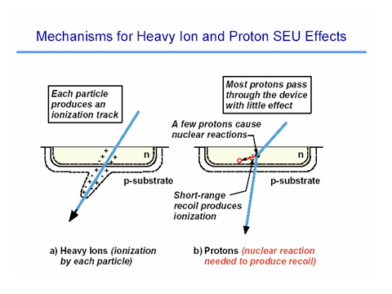
Single Event Effects (SEE)
Single event effect (SEE) : current generated by ion passing through the sensitive volume of a biased electronic device changes the device operating state
SEE Generated by Heavy Ions (Z=2-92)
High linear energy transfer (LET) rate of heavy ions produces ionization along track as ion slows down
Dense ionization track over a short range produces sufficient charge in sensitive volume to cause SEE
SEE is caused directly by ionization produced by incident heavy ion particles
SEE Generated by Protons (Z=1)
Proton LET is too low to generate SEE, but secondary heavy ions are produced in nuclear reactions with nuclei of atoms (usually silicon) inside electronics. Energy is transferred to a target atom fragment or recoil ion with high LET and charge deposited by recoil ion(s) is the direct cause of SEE.
Only a small fraction of protons are converted to such secondary particles (1 in 10⁴ to 10⁵).
Notes:
Single event effects in electronics are current pulses generated by passage of high energy ions through sensitive electronics. The current pulse represents a signal in an electronic circuit that may have a number of effects including stray noise in circuits, changing bits in storage devices from 0 to 1 or 1 to 0. In extreme cases, the current pulses can be sufficiently large to damage or destroy an electronic part. SEE’s are a major space environment effect with a slowly varying change in rate due to GCR over the period of a solar cycle and very rapid changes in upset rates in very sensitive parts during SPE’s.
Only heavy ions can directly generate upsets because they generate sufficient ionization along their path through the sensitive region of an electronic part. Protons generally do not generate enough ionization so their current pulse is very low. However, nuclear interactions between high energy protons from SPE or GCR sources and heavy ion target atoms in the electronic device can generate secondary ions that will produce sufficient ionization to produce an upset. Therefore both heavy ions and energetic protons can generate single event upsets.

Slide 9
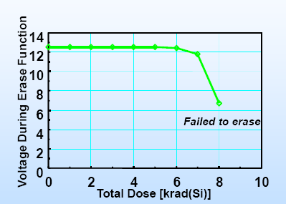
Total Ionizing Dose
Cumulative ionizing damage due to proton and electron energy deposition in materials
  Electron, hole pairs responsible for long term effects due to charge trapping at damage sites
  Modifies electrical characteristics of electronic devices
  Darkening, damage of materials (optics, fiber optics, dielectric filters)
  Breaking bonds modifies chemical structure (polymers, epoxy binders)
Effects in electronics
  Leakage currents
  Threshold shifts
  Timing changes
  Functional failures
Shielding partially mitigates the effects by reducing of low energy protons, electrons
Computer Memory
LaBel, 2003
1 Gray = 1 Joule/kilogram = 100 rad
1 centiGray = 1 rad
Notes:
Total ionizing dose is the energy deposited per unit mass when a charged particle or energetic photon ionizes the constituents of the material they are passing through. The absorbed energy can modify the structure of the material resulting in damage to electronics. The example in the figure is the gradual change in the voltage required to implement an erase function in a computer memory. The voltage drops after a total dose of some 6000 rads and the device no longer is able to complete the erase function. This demonstrates a failure mechanism in a computer memory due to high radiation dose.

Slide 10
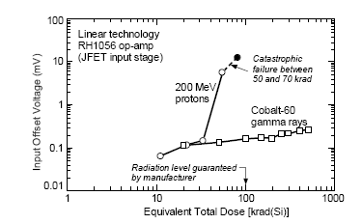
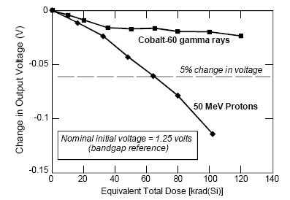
Displacement Damage
Cumulative non-ionizing damage due to proton, electron, and neutrons
  Particle impact of displaces ion from lattice position
  Creates charge trapping sites, modifies electrical behavior of material
Effects in electronics
  Accumulation of defect sites result in device degradation
  Optocouplers, solar cells, imagers (e.g., CCD’s), lnear bipolar devices
Shielding partially mitigates the effects by reducing low energy protons, electron damage
  High energy protons, neutrons are difficult to shield
[Rax et al. 1999]
TID,DD
TID
RH1056 op-amp degradation acceptable for gamma ray exposure, fails when exposed to protons
TID
TID,DD
[Rax et al. 1999]
National LM117 output voltage modified by exposure to gamma rays, protons
Notes:
Displacement damage is the cumulative damage due to charged particles and neutrons where the target material is not ionized but rather the ions are displaced from their lattice positions. This still represents a damage mechanism to the material and will result in changes of operating properties of electronics.

Slide 11
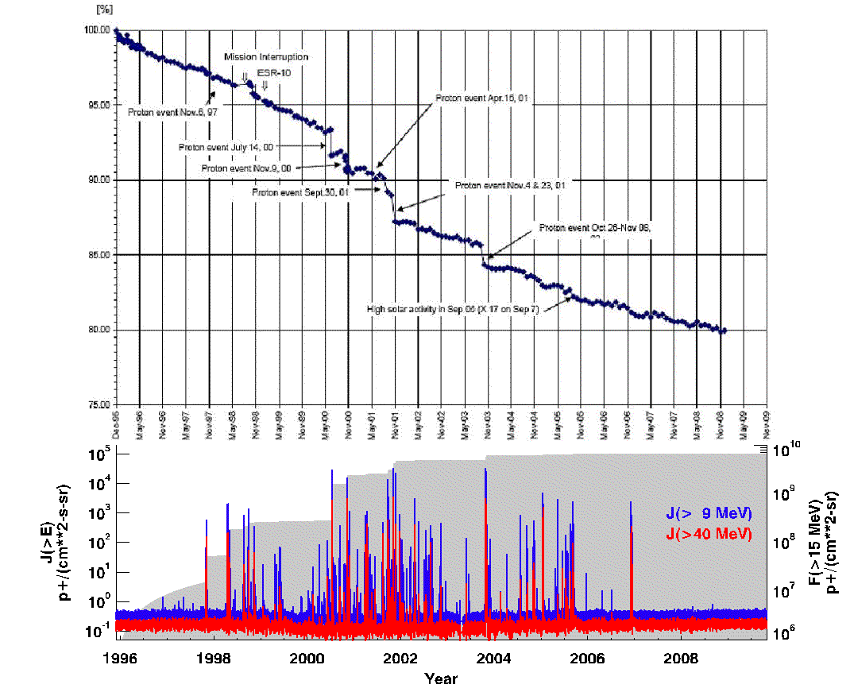
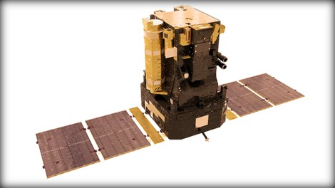
ESA SOHO Solar Array Degradation
ESA
I(t)/I(t=0)
SOHO
Sun-Earth L1
[Ton van Overbeek, 2009]
Notes:
Solar arrays exposed to radiation environments will slowly lose their ability to produce power. The top panel shows the average current from a solar array on the European Space Agency (ESA) Solar and Heliospheric Observatory (SOHO) spacecraft operating at the Sun-Earth L1 point in interplanetary space. The ratio of array output current as a function of time to the initial output current is shown in the top panel. There is a gradual decay over time because radiation is always present in the space environment. However note that large decreases in output current occur at times of large solar particle events. The integral flux of >9 MeV (blue) and >40 MeV (red) protons is shown in the bottom panel along with the integral fluence of >15 MeV protons (gray). Only the largest solar particle events result in significant decreases in solar array current.

Slide 12
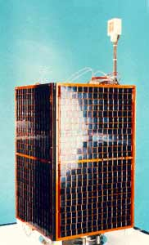
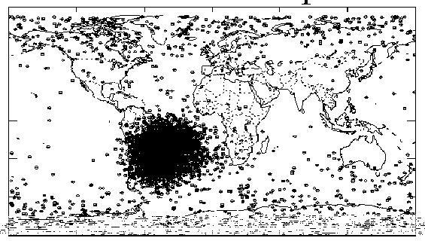
UoSAT-3 Single Event Upsets
University of Surrey Satellite (UoSAT)
780 km, 98° inclination
[http://www.esa.int/TEC/Space_Environment/SEMQ95T4LZE_0.html]
Notes:
Locations where single event upsets in UoSAT electronics are observed in a low Earth orbit, sun-synchronous orbit are shown on the map. The very large number of upsets in the South Atlantic Anomaly are due to exposure of the electronics to the energetic protons in the inner radiation belt. The additional upsets which are more prevalent at high latitudes are due to the combined effects of GCR and SPE’s.

Slide 13
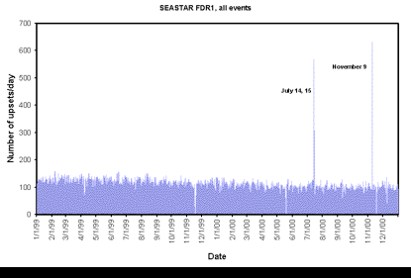
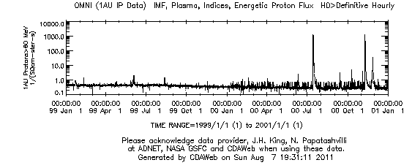
SeaStar Satellite Single Event Upsets (SEU)
SeaStar satellite
  705 km, 98.2° inclination
Flight Data Recorder SEU counts
Daily rate is just over 100 SEU per day
  Slowly decreasing as background GCR flux decreases
Two periods with enhanced SEU are due to solar proton events
  15-16 July 2000
  9 November 2000
Katz, 2004
Notes:
In order to see the changes in upset rate due to space weather effects it is better to examine variations in upset rates as a function of time. The plot in the top panel shows upset rates in a flight data recorder on a sun-synchronous orbit satellite. The rate is nearly constant in time with a gradual decay over time due to the slowly decreasing GCR flux as solar activity increases. The upset rates increase dramatically in July and November 2000 during SPE’s. The integral flux of >60 MeV protons is given in the bottom panel to show that the increase in upset rate is due to space weather events.

Slide 14
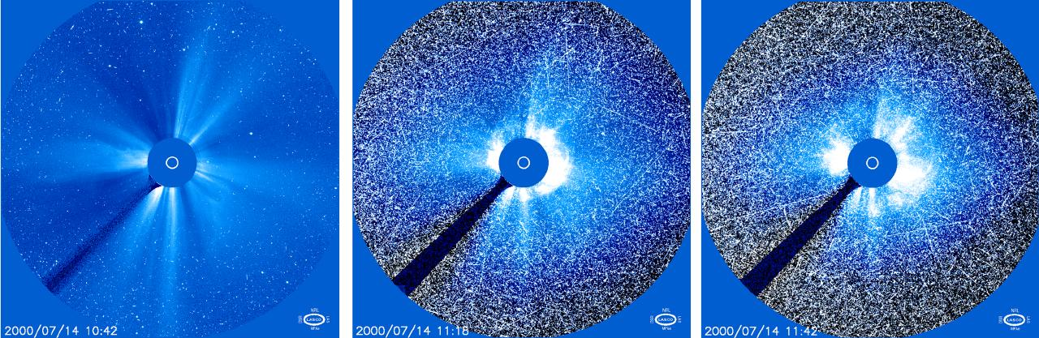
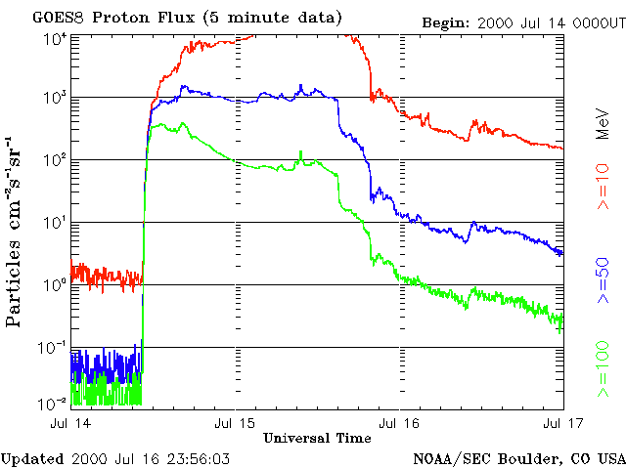
Solar Particle Events, CCD Imagers
SOHO (L1) 14 July 2000 “Bastille Day Event”
10:42 UT 11:16 UT 11:42 UT
Notes:
SPE’s can have dramatic impact on CCD imaging systems. Images from the SOHO coronagraph become increasingly noisy due to SPE interactions with the CCD detectors during the large SPE event in July 2000. An expanding CME is still visible in the coronagraph images in this example although in some cases CCD images may become so noisy the science data is lost. Energetic particle noise can be a particularly bad problem in the CCD imagers used in star trackers because the noise will mask the individual stars and the tracker system will lose the ability to sense direction in space.

Slide 15

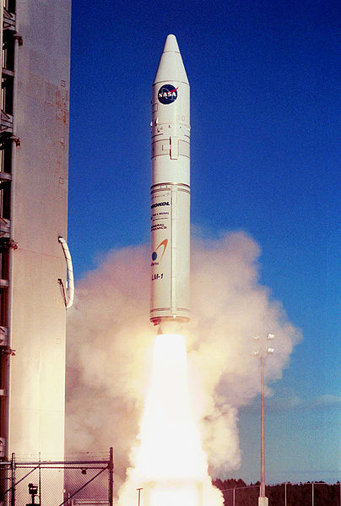
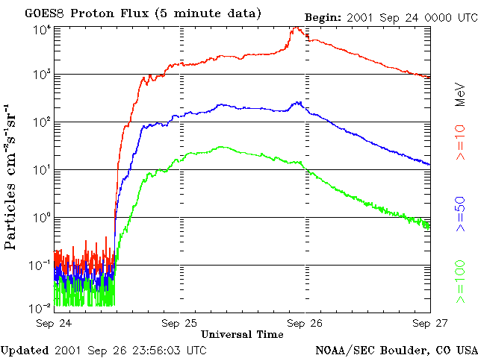
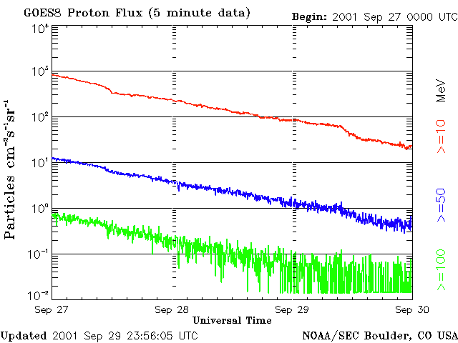
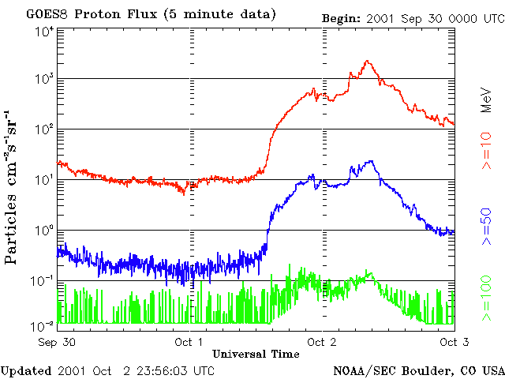
Launch Delay of NASA/DOD Kodiak Star Mission
Kodiak Star scheduled for September 2001 launch from Kodiak Launch Complex (Alaska) on Athena (Lockheed Martin) rocket
Launch criteria: J(>10 MeV) < 10 particles/cm²-s-sr
16 Sep: launch operations start, launch approved for 21 Sep
21 Sep: scrub due to terrestrial weather
22 Sep: scrub due to range tracking radar hardware problems, next attempt deferred to 24 Sep
24 Sep: scrub due to solar proton event
25 Sep: scrub due to solar proton event, next attempt deferred to 27 Sep
27 Sep: scrub due to solar proton event, terrestrial weather, next attempt deferred to 29 Sep
29 Sep: attempt begins with radar issues and proton flux out of limits; radar problem is corrected
30 Sep: proton flux decreases to less than constraint value allowing launch at 02:40 UT on 30 Sep
Launch
02:40 UT
J(>10 MeV) = 10 pfu
  http://www.spaceflightnow.com/athena/kodiakstar/status.html
Sardonia and Madura, 2002
Notes:
Launch operations can also be impacted by space radiation. Some launch vehicles are not designed with sufficiently robust electronics systems to withstand the hazards of long term missions ni space because their total operating life is limited to a period of tens of minutes to a few hours. Launch operators may choose to protect their launch vehicle electronics from the hazards of SPE’s by monitoring energetic particle data in real time and deferring launch of the proton flux exceeds an established threshold. The example shown here is a six day launch delay due to a solar proton event where the launch operators choose to defer launch if the >10 MeV proton flux exceeded 10 protons/cm2-sec-sr.

Slide 16
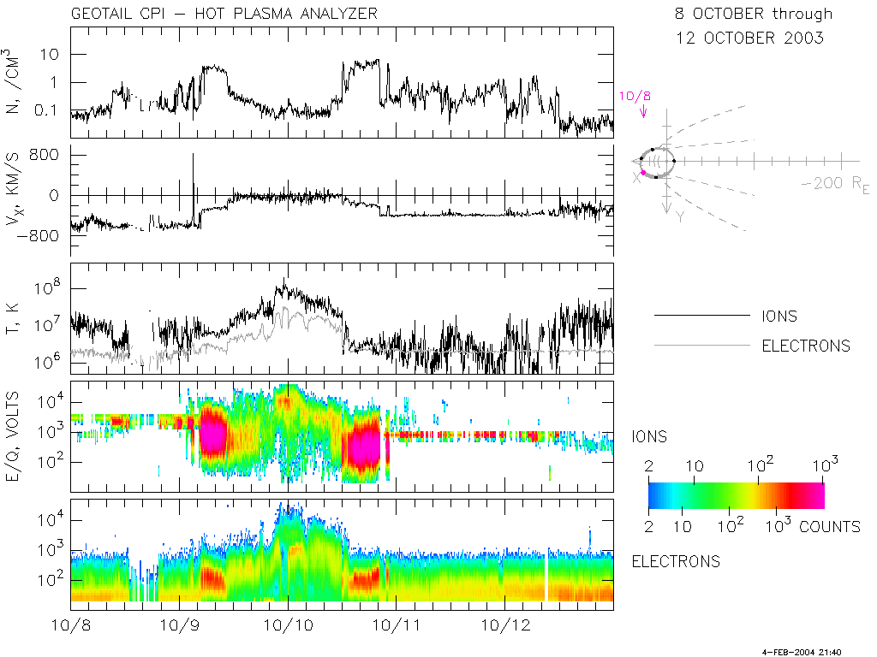
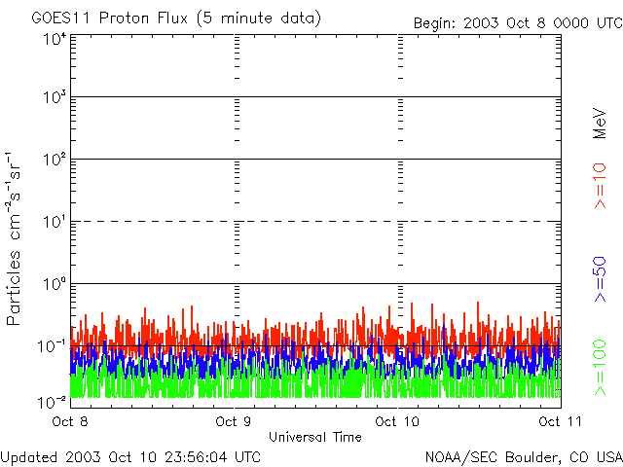
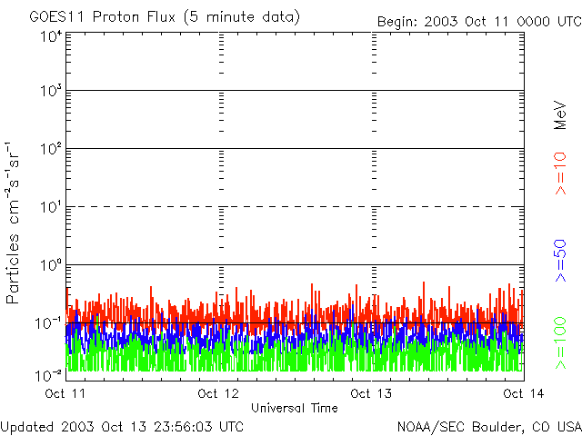
Impact on Science Data Quality
SW solar wind
MS magnetosheath
Msph magnetosphere
GEOTAIL CPI/HPA Univ of Iowa
i⁺
e⁻
SW
MS
Msph
SW
MS
http://www-pi.physics.uiowa.edu/www/cpi/
Notes:
Space weather can impact the quality of science data. The top panel is a nice example of the ion (top frame) and electron (bottom frame) flux from the Geotail spacecraft in a 10 Re x 30 Re orbit about the Earth. Clear signatures of the solar wind, magnetosheath, and magnetosphere plasma regions can be seen over the five day period of one orbit. Energetic particle data from the GOES-11 spacecraft in GEO show only background flux. There is no space weather event in progress during this period from early October 2003. However, the next plot shows what happens when a space weather event begins…..

Slide 17
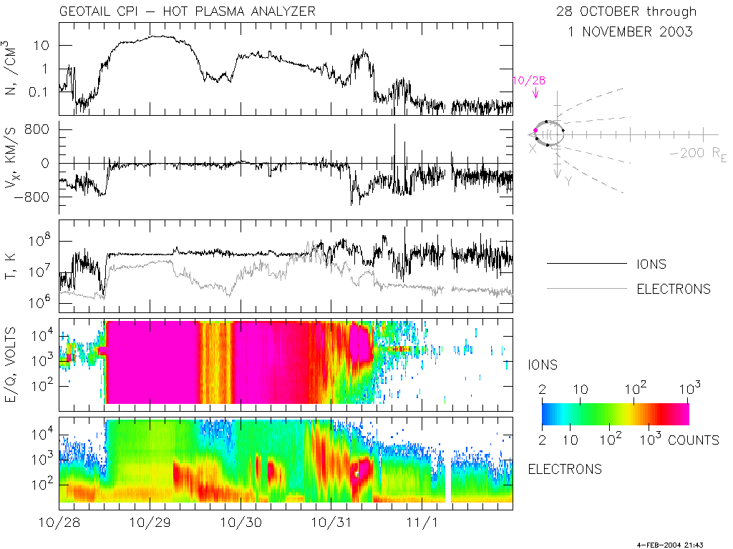
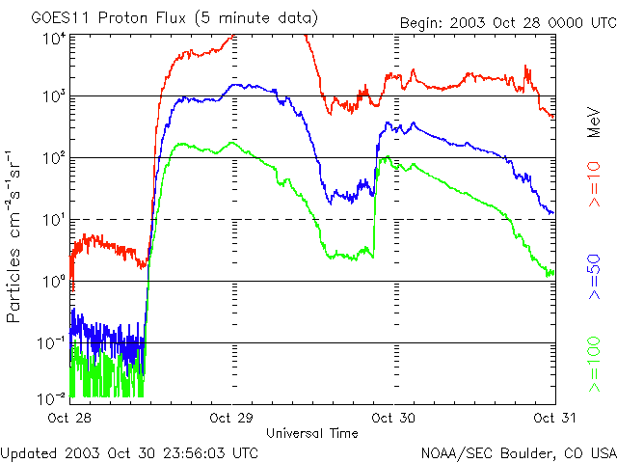
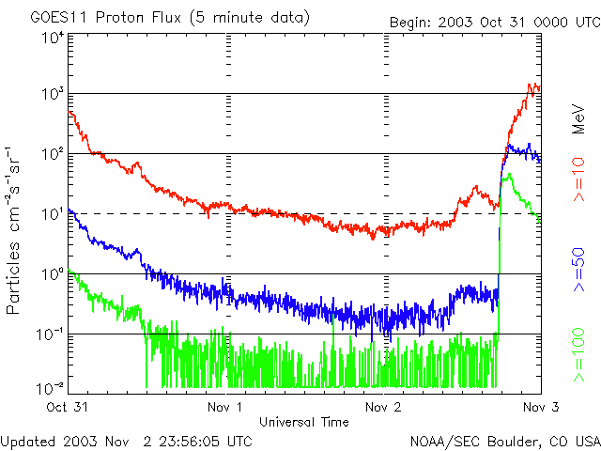
SPE Data Contamination of Geotail CPI/HPA Data
GEOTAIL CPI/HPA Univ of Iowa
i⁺
e⁻
SPE
http://www-pi.physics.uiowa.edu/www/cpi/
Notes:
The individual solar wind, magnetosheath, and magnetsphere plasma regions are no longer visible during the large SPE’s in late October 2003. Instead, both the ion and electron detectors are saturated by high energy particles (top panel) during the period the GOES-11 instruments in GEO (bottom panel) indicate significant flux of energetic protons are present. This example is from the “Halloween 2003” solar particle events which had major impact on many spacecraft. Fortunately for Geotail, the poor science data during the storm recovered quickly after the proton flux decreased without any lasting impact to the CPI/HPA instrument.

Slide 18
Chandra X-Ray Observatory
Solar Cycle 24 Radiation Interventions
Event* | Start | End | Lost Science time | Auto/Manual | Cause (HRC/EPHIN/ACE)
3 (+1) | 2011 |  | 406 ks (113 hr) | 2/1 | 2/0/1
1** | Jun 7 15:23 UT | Jun 8 12:50 UT | 74.9 (20.8) | Auto | HRC (hard)
2 | Aug 4 07:03 | Aug 7 10:25 | 270.4 (75.1) | Auto | HRC (hard)
3 | Oct 24 18:27 | Oct 25 22:35 | 61.1 (17.0) | Manual | ACE P3’ (soft)
4 | Oct 26 11:40 | Oct 28 12:33 | 154 (42.8) | Auto | Command Telemetry Unit (SEU)
10 | 2012 |  | 1,246 ks (346 hr) | 7/3 | 5/2/3
5 | Jan 23 06:00 | Jan 26 08:27 | 192.1 (53.4) | Auto | HRC (hard)
6 | Jan 27 19:39 | Jan 30 02:20 | 163.4 (45.4) | Auto | HRC (hard)
7 | Feb 27 03:24 | Feb 27 20:23 | 61 (16.9) | Manual | ACE P3’ (soft)
8 | Mar 7 05:30 | Mar 13 05:14 | 440 (122.2) | Auto | HRC (hard)
9 | Mar 13 22:41 | Mar 14 13:57 | 53.3 (14.8) | Auto | HRC (hard)
10 | May 17 02:18 | May 18 04:52 | 93.8 (26.1) | Auto | E1300 (hard)
11 | Jul 12 19:59 | Jul 14 00:09 | 61.7 (17.1) | Auto | E1300 (hard)
12 | Jul 14 21:08 | Jul 16 05:16 | 80.1 (22.3) | Manual | ACE P3’ (soft)
13 | Jul 19 11:44 | Jul 20 04:09 | 56.5 (15.7) | Auto | HRC (hard)
14 | Sep 3 12:57 | Sep 4 12:41 | 44.5 (12.4) | Manual | ACE P3’ (soft)
3 | 2013 Q2 |  | 283 ks (78 hr) | 1/2 | 0/0/1
15 | Mar 17 12:32 | Mar 19 05:58 | 105.7 (29.4) | Manual | ACE P3’ (soft)
16 | May 22 14:49 | May 24 12:22 | 123.6 (34.3) | Auto | ACIS (hard)
17 | May 24 20:41 | May 25 11:56 | 54.0 (15.0) | Manual | ACE P3’ (soft)
* Solar-cycle-24 radiation interventions: Chandra Radiation Central http://asc.harvard.edu/mta/RADIATION/
** First radiation interruption since 2006 December 13
Notes:
Operations of NASA’s Chandra X-ray Observatory is also impacted by space weather events. The CCD detectors used in the Advanced CCD Imaging Spectrometer (ACIS) instrument can be damaged by exposure to protons with energies of about 100 keV to 200 keV. The Chandra operations team has implemented a set of radiation mitigation techniques to limit exposure to solar protons in this energy range during space weather events. The process efficiently protects ACIS from significant radiation damage but at the cost of lost science operation time. Two types of radiation interventions occur when science operations are terminated and the ACIS instrument moved to a position safe from radiation. Automated interventions occur without operator input because systems on-board the spacecraft are capable of sensing a high flux of “hard” solar protons exceeding 10 MeV in energy and generating a signal that moves ACIS to the safe position protected from radiation. Manual events are generated by ground operators who monitor the “soft” flux of 100’s keV protons in the real-time data stream obtained from the NASA Advanced Composition Explorer (ACE) satellite and distributed by the NOAA Space Weather Prediction Center. This slide shows a summary of radiation intervention events from a few years near the peak of Solar Cycle 24 (the current cycle).

Slide 19
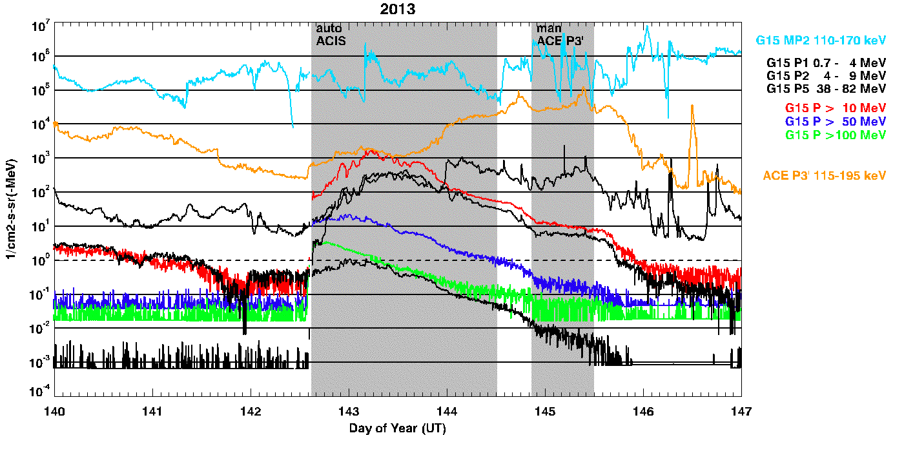
Auto ACIS, Manual ACE P3’
Start: 22, 24 May
M5.0 flare
~1200 km/s CME
Peak ~13:32 UT
IP Shock at L1
~17:35 UT
Notes:
Space environment records during two of the Chandra radiation intervention periods (gray bars). An automatic intervention occurs first on GMT 142 when science operations are stopped due to the rapid increase in high energy protons during a SPE that accompanied a large x-ray flare and fast CME. The operators restarted the science operations mid day on GMT 144 but they were stopped again by a manual intervention late on GMT 144 due to the very high flux of ~100 to 200 keV protons that followed an interplanetary shock observed by ACE at L1. This series of space weather events in 2013 resulted in a loss of about 49 hours science observing time.

Slide 20
Surface Charging Current Balance
Time dependent current balance
Currents
plasma
at equilibrium
incident ions
incident electrons
backscattered electrons
conduction currents
secondary electrons due to I_{e}
secondary electrons due to I_{i}
photoelectrons
active current sources (beams, thrusters)
(Garrett and Minow, 2004)
Notes:
Spacecraft surface charging is a current balance process where the charge density and voltage on a spacecraft surface is due to the balance of currents to and from the surface.
The basic equation of charging indicates that the variation of charge Q as a function of time t is due to the sum of currents to a surface. The time variation of surface voltage V can be estimated if the capacitance C is known.

Slide 21
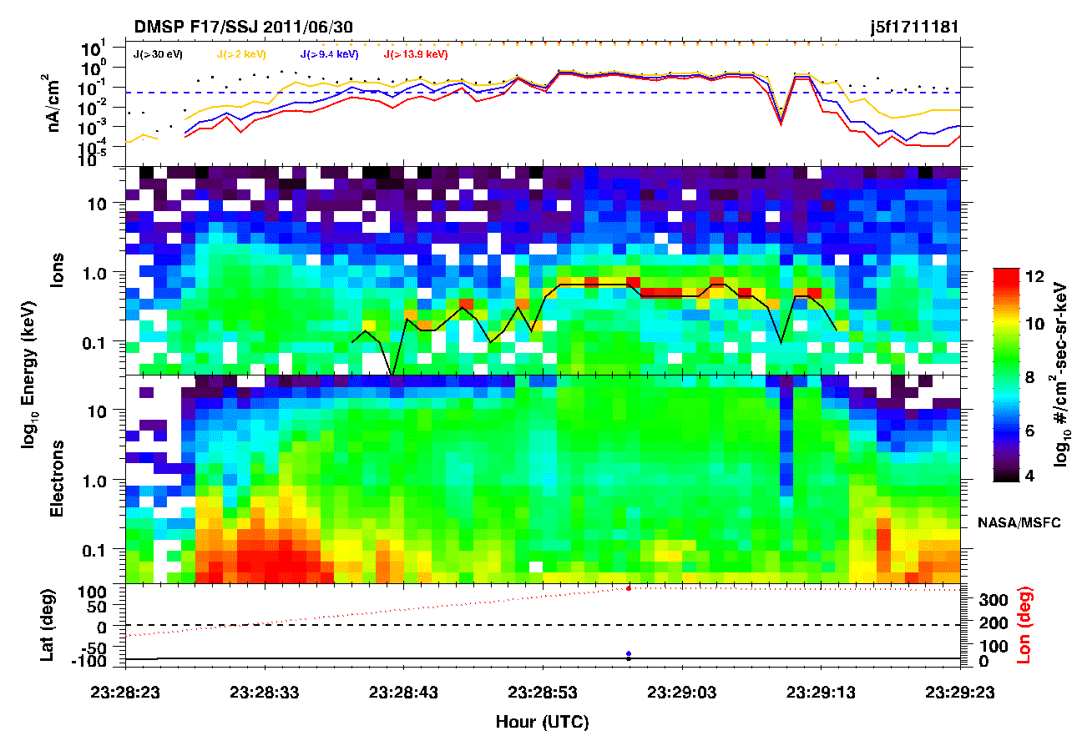
“Ion Line” Charging Signature, φ_{s/c} < 0
Low energy background ions accelerated by spacecraft potential show up as sharp “line” of high ion flux in single channel
E = E₀ + qΦ
Assume initial energy E₀ ~ 0 with single charge ions (O⁺, H⁺) and read potential (volts) directly from ion line energy (eV)
Accuracy of potential measurement set by energy width and separation of the energy channels used to infer the potential
-646 volts
Notes:
One method of determining the potential on a spacecraft surface is to use the “ion line” charging signature that is often present in electrostatic particle detector data. Low energy ions will be attracted to a negatively charged spacecraft and arrive with an increased energy as they are accelerated through the potential due to the charged spacecraft. When ion flux is plotted as a function of particle energy in electron volts the potential can be simply read off the plot in volts. The example here shows negative charging to about 650 V.

Slide 22
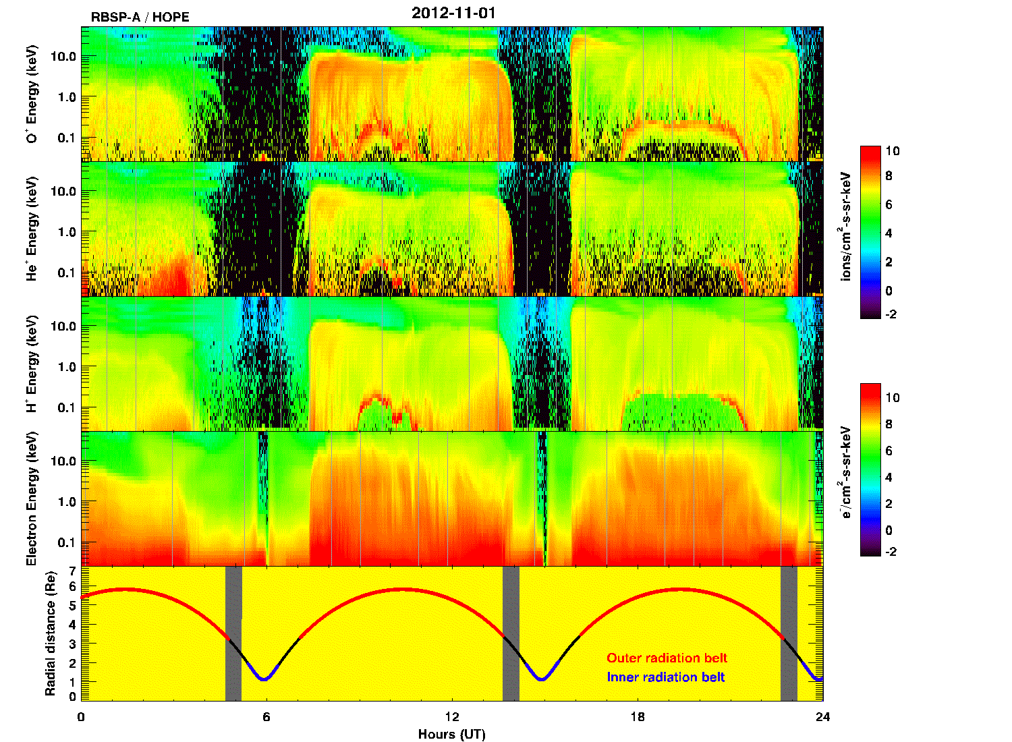
Van Allen Probe-A (GTO)
-200 V
[Thomson et al., 2013]
[Parker and Minow, 2014]
Notes:
Surface charging examples along GTO orbits in data from NASA’s Van Allen Probe-A spacecraft. Ion line charging signatures in two orbits indicate the spacecraft charge to potentials of about -200 V on 1 November 2012.

Slide 23
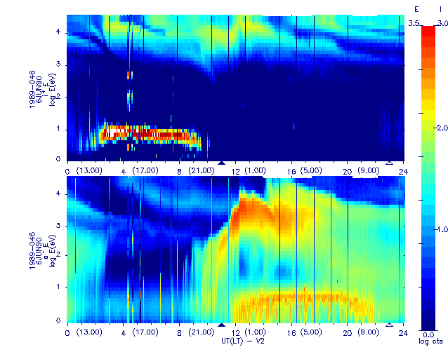
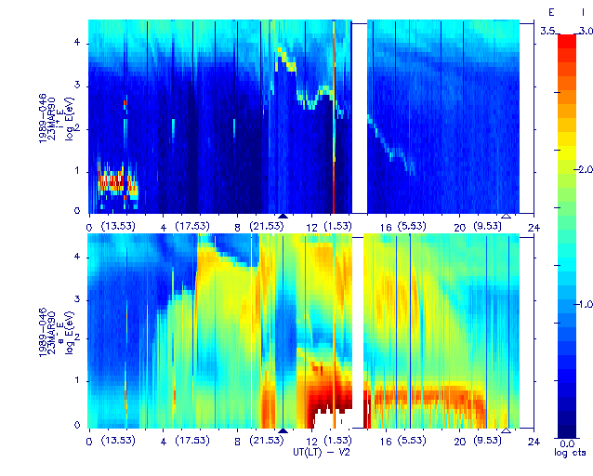
Los Alamos GEO Spacecraft
LANL 1989-046 6 June 1990
LANL 1989-046 23 March 1990
-8000 V
no charging
~ 8 kV in eclipse
~ 1 kV post midnight
During periods of significant hot plasma injection, spacecraft may become significantly charged relative to background plasma
Notes:
A more extreme example of spacecraft surface charging to about -8000 V is shown in the right panel. The ion line charging signature indicates a maximum potential during spring equinox eclipse conditions around local midnight (marked by the black triangle). Charging continues into the post midnight hours although the level decreases when the spacecraft moves into sunlight.
The left panel is the same spacecraft later in the summer for a period of no charging to highlight the differences between the presence and absence of the ion line charging signature. The Los Alamos National Laboratory (LANL) satellite operate in GEO.

Slide 24
GEO Surface Charging
Olsen [1983]
I⁺,e⁻ flux
Surface charging anomalies typically occur in midnight to dawn local time sector where hot electrons are injected during geomagnetic substorms
Record ATS-6 charging event
Φ ~ -19 kV
Notes:
A very extreme GEO charging case in shown in the right panel from the Applied Technology Satellite (ATS) 6 spacecraft. This event is the record charging event from the ATS-6 mission and the potential reached a value of about -19,000 V. Note the energy scale in the ion frame is inverted in the ATS-6 records.
Examples of local time distributions of charging anomalies are shown in the diagram in the left panel. This figure from NOAA demonstrates that surface charging is most common in the midnight and dawn sector because the hot electron (ion) plasma is driven eastward (westward) by the combined effects of the gradient-B and curvature forces on the hot plasma.

Slide 25
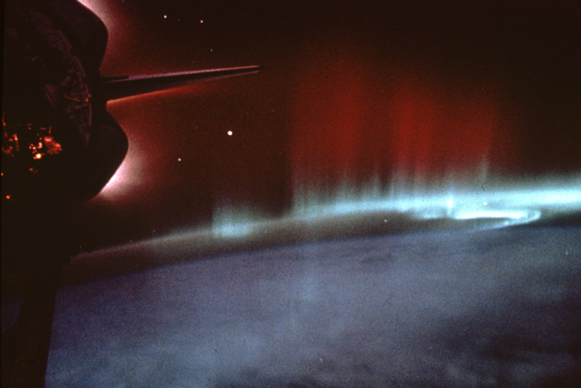
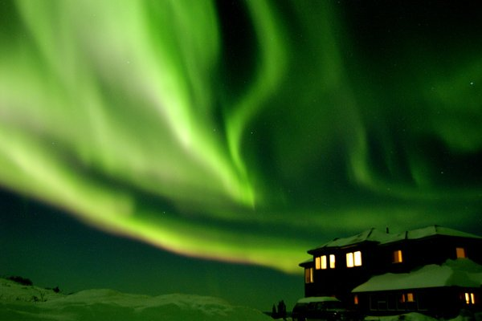
Auroral Charging
Auroral charging is controlled by
Energy of primary electrons and secondary electron yields
Density of ambient plasma (to balance auroral electron collection)
Examples of low Earth orbit charging in the auroral zone include
DMSP ~830 km, 98 deg
-10’s V > Φ > -1500 V
Freja 590 km x 1763 km, 63 deg
-10’s V > Φ > -3000 V
Notes:
Strong auroral acceleration at high latitudes can be a source of charging for spacecraft in low Earth, polar orbits. Details of the electron energy spectrum are important as well as the secondary electron yield properties of the materials because these two parameters determine if there is a net increase or decrease in electrons on the spacecraft surface.

Slide 26
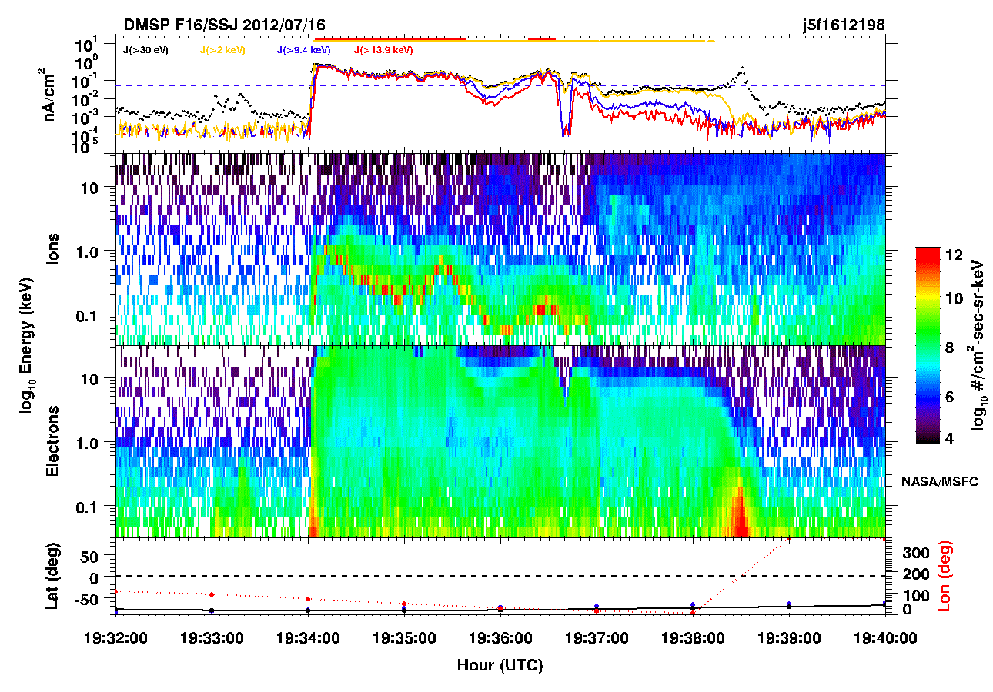
Auroral Charging
Auroral charging is controlled by
Energy of primary electrons and secondary electron yields
Density of ambient plasma (to balance auroral electron collection)
Φ ~ -1000 V
Examples of low Earth orbit charging in the auroral zone include
DMSP ~830 km, 98 deg
-10’s V > Φ > -1500 V
Freja 590 km x 1763 km, 63 deg
-10’s V > Φ > -3000 V
Notes:
An example of a strong ion line charging signature from the DMSP F16 spacecraft that indicates a potential of -1000 V for a few seconds. In this case the charging occurs in the southern hemisphere during July which is local winter conditions.

Slide 27
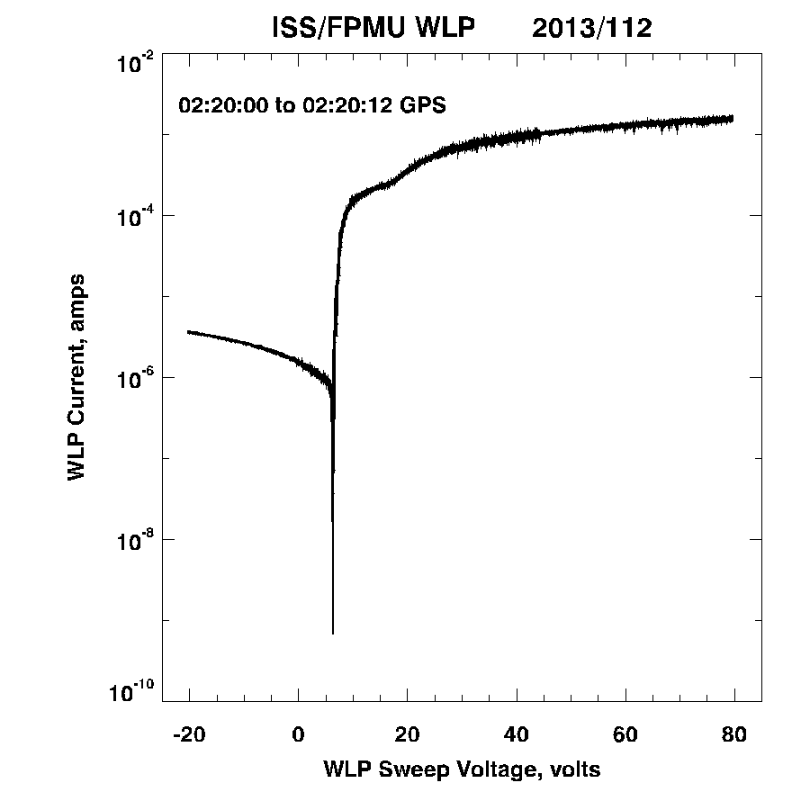
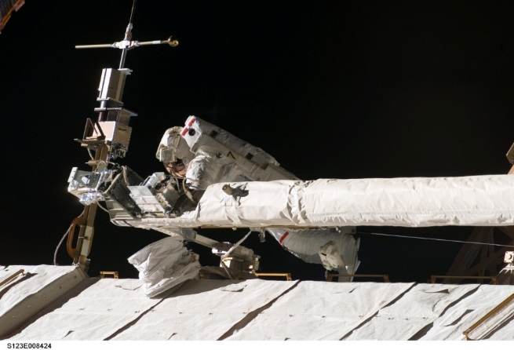
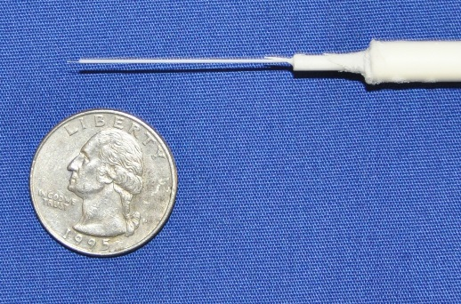
Langmuir Probe
Current probe techniques have been widely used for many years to measure spacecraft potentials
Technique is based on measuring current collected by probe as a function of the probe voltage
I_{e}(V)
electron collection
electron retardation
HH MM SS.MSEC Ni Te Vflt Vsp
<------ GPS ------> (m-3) (K) (volt) (volt)
--------------------------------------------------------------------
02 20 00.668 7.06e+10 1.95e+03 6.39 7.10
02 20 01.668 7.08e+10 1.46e+03 6.39 6.91
02 20 02.672 7.30e+10 1.51e+03 6.37 6.91
02 20 03.672 7.03e+10 1.24e+03 6.39 6.81
02 20 04.672 7.20e+10 1.76e+03 6.32 6.98
02 20 05.672 6.92e+10 1.68e+03 6.37 6.98
02 20 06.676 7.24e+10 1.61e+03 6.39 6.93
02 20 08.676 7.28e+10 1.55e+03 6.32 6.86
02 20 09.680 7.20e+10 1.45e+03 6.42 6.91
02 20 10.680 7.26e+10 1.56e+03 6.29 6.88
02 20 11.680 7.07e+10 1.74e+03 6.37 7.03
--------------------------------------------------------------------
−I_{i}(V) ion collection
Vfloat Vspace
[from Merlino, 2007]
Floating Potential Measurement Unit
0.8 m
Notes:
Another method of monitoring spacecraft potential is to use a current probe, the Langmuir probe is a classic example. Currents to the probe are measured as a function of probe voltage.
Ion currents are measured when the probe voltage is negative and electron currents are measured when the probe voltage is positive. The ion and electron currents are a function of the spacecraft potential relative to the ambient plasma environments, the electron temperature, the electron density, and the ion density. Probe voltages range in size from very small devices used on CubeSats to the large Floating Potential Measurement Unit (FPMU) instrument on the International Space Station (ISS). A set of eleven current-voltage curves from the Wide Langmuir Probe, one of the FPMU instruments on ISS, is shown in the upper right panel along with a table of density, temperature, and potential values derived from the curves. The FPMU data is used to characterize charging of the ISS in a 51.6 degree inclination, ~400 km altitude low Earth orbit.

Slide 28
International Space Station: 15 July 2012
Potential variations due to (a) vxB.L (b) eclipse exit solar array (c) auroral charging
mlat
Notes:
Example of FPMU data for six orbits on 15 July 2012 showing spacecraft potential (top frame), ion density and electron temperature (middle frame), and spacecraft ephemeris (bottom frame).
The oscillating (v x B).L induced potential is due to motion of the spacecraft through the Earth’s magnetic field and is not the result of charging. Charging occurs at sunrise when the solar arrays develop a voltage and begin to collect current. Additional charging variations are present at high southern latitudes during the night and are due to auroral charging.

Slide 29

Internal (Deep Dielectric) Charging
High energy (>100 keV) electrons penetrate spacecraft walls and accumulate in dielectrics or isolated conductors
Threat environment is energetic electrons with sufficient flux to charge circuit boards, cable insulation, and ungrounded metal faster than charge can dissipate
Accumulating charge density generates electric fields in excess of breakdown strength resulting in electrostatic discharge
System impact is material damage, discharge currents inside of spacecraft Faraday cage on or near critical circuitry, and RF noise
inches
PMMA (acrylic) charged by ~2 to 5 MeV electrons
Notes:
Internal charging is the result of exposure to very high energy electrons that penetrate deep into materials or inside the spacecraft. Internal charging can be a major threat because arcing that results from internal charging can damage materials or couple to circuits and damage sensitive components.
The example here is a plastic block charged by exposure to electrons with energies of 2 to 5 MeV in a laboratory facility. When the block is removed from electron beam and struck with a sharp grounded point, a discharge occurs that produces the damage pattern in the material.

Slide 30
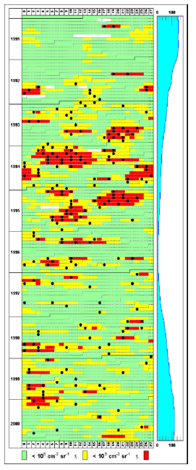
GOES Solar Cycle 21 Internal Charging Anomalies (GEO)
smoothed sunspot number
Day in solar rotation period
1991 | 1992 | 1993 | 1994 | 1995 | 1996 | 1997 | 1998 | 1999 | 2000
Black: GOES phantom commands
2-day fluence (F2) > 2 MeV electrons
Red: F2 ≥ 10⁹ e⁻/cm²-sr
Amber: 10⁹ > F2 ≥ 10⁸ e⁻ /cm²-sr
Green: F2 < 10⁸ e⁻ /cm²-sr
White: no data
[adapted from Wrenn et al. 2002 ]
Notes:
Solar cycle variations in phantom commands due to current pulses within the avionics systems on the GOES spacecraft. The plot is organized with time in years on the horizontal axis, day of solar rotation cycle on the vertical axis, and the 2-day fluence of >2 MeV electrons color coded to indicate periods of high fluence. The large blocks of high fluence indicate periods of enhanced electron flux recurring once every solar rotation cycle. These space weather features are due to high speed solar wind streams origination in solar corotating interaction regions. Note that the GOES phantom commands are typically correlated with the high flux periods and are therefore a space weather phenomenon.

Slide 31
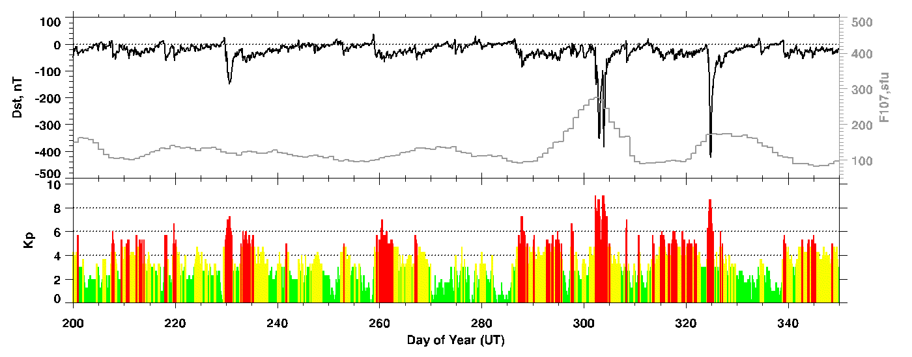
2003 Halloween Storm Impacts on Spacecraft (1)
Oct 23: Genesis satellite at L1 entered safe mode, normal operations resumed on Nov. 3.
Midori-2 (ADEOS-2) Earth-observing satellite power system failed, safe mode,
telemetry lost (23:55), spacecraft lost
Oct 24: Stardust comet mission went into safe mode due to read errors; recovered.
Chandra X-ray Observatory astronomy satellite observations halted due to high
radiation levels (09:34EDT), restarted Oct. 25
GOES-9, 10 and 12 had high bit error rates (9 and 10), magnetic torquers disabled
due to geomagnetic activity
Oct 25: RHESSI solar satellite had spontaneous CPU reset (10:42)
Oct 26: SMART-1 had auto shutdown of engine due to increased radiation level in lunar transfer
orbit (19:23)
Oct 27: NOAA-17 AMSU-A1 lost scanner
GOES-8 X-ray sensor turned itself off and could not be recovered
Oct 28-30: Astronauts on Intl. Space Station went into service module for radiation protection
Instrument on Integral satellite went into safe mode because of increased radiation
Chandra observations halted again autonomously, resumed Nov 1
Notes:
The “Halloween Storm” period in late October 2003 was one of the most severe solar and geomagnetic activity periods in recent years. This slide and the next two slides are a collection of space weather impacts on spacecraft reported during this storm period. Impacts vary from minor interruptions to routine operations to severe impacts on spacecraft systems and even a complete loss of one spacecraft.

Slide 32
2003 Halloween Storm Impacts on Spacecraft (2)
Oct 28: DMSP F16 SSIES sensor lost data twice, on Oct. 28 and Nov. 3; recovered.
microwave sounder lost oscillator; switched to redundant system
SIRTF, in orbit drifting behind Earth, turned off science experiments and went to
Earth pointing due to high proton fluxes, 4 days of operations lost
Microwave Anisotropy Probe spacecraft star tracker reset and backup tracker
autonomously turned on, prime tracker recovered
Oct 29: Kodama data relay satellite in GEO; safe mode, signals noisy, recovery unknown
RHESSI satellite had 2 more spontaneous resets of CPU (28, 17:40; 29, 03:32).
CHIPS satellite computer went offline on Oct. 29 and contact lost with the spacecraft
for 18 hr. When contacted the S/C was tumbling; recovered successfully. Offline
for a total of 27 hrs.
X-ray Timing Explorer science satellite Proportional Counter Assembly (PCA)
experienced high voltages and the All Sky Monitor autonomously shut off, both
instruments recovered Oct 30 but PCA again shut down. PCA recovery delayed
into November.
adapted from Allen and Wilkerson, 2010
http://www.ngdc.noaa.gov/stp/satellite/anomaly/2010_sctc/docs/1-1_JAllen.pdf

Slide 33
2003 Halloween Storm Impacts on Spacecraft (3)
Oct 28-31: CDS instrument on SOHO spacecraft at L1 commanded into safe mode for 3 days
Mars Odyssey spacecraft entered safe mode, MARIE instrument had a temperature
red alarm leading it to be powered off (Oct. 28). S/C memory error during
downloading on 29 Oct corrected with a cold reboot on Oct. 31
Both Mars Explorer Rover spacecraft entered “sun idle” mode due to excessive
start tracker events
Oct 29: NASA’s Earth Sciences Mission Office directed all instruments on 5 spacecraft be
turned off or safed due to Level 5 storm prediction. Satellites affected include
AQUA, Landsat, TERRA, TOMS, and TRMM
Oct 30: ACE & Wind solar wind satellites lost plasma observations
Electron sensors of GOES satellite in geosynchronous orbit saturated
Nov 2: Chandra observations halted again autonomously due to radiation. Resumption of
observations delayed for days
Nov. 6: Polar TIDE instrument reset itself and high voltage supplies were disabled; recovered
within 24 hr.
Mars Odyssey spacecraft commanded out of Safe mode; operations nominal.
adapted from Allen and Wilkerson, 2010
http://www.ngdc.noaa.gov/stp/satellite/anomaly/2010_sctc/docs/1-1_JAllen.pdf

Slide 34
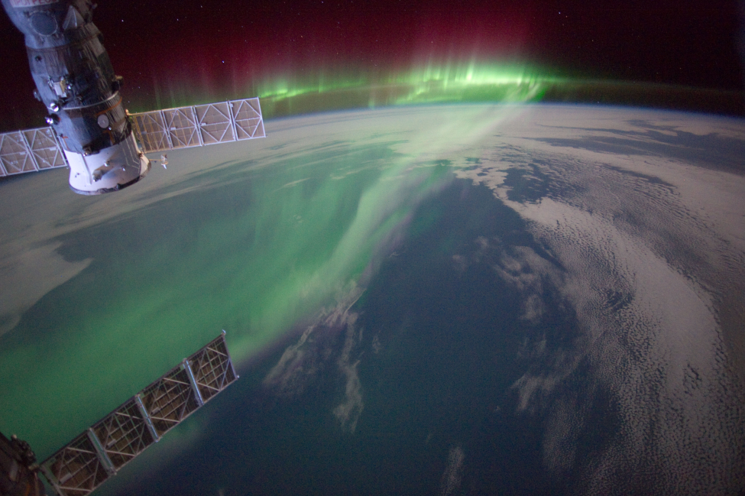
Questions?
iss030e131395.jpg
GMT: : 2012:03:07 16:18:15

Slide 35
Quiz
Spacecraft in what orbits are most likely to experience surface charging? Extreme surface charging?
What orbits are a concern for single event upsets?
What orbits are a concern for total ionizing dose from solar particle events?
You are designing a mission to Mars, what environments are a concern for radiation and charging during the period from launch, transit to Mars, and arrival at Mars?

